Slide 1
Sms spam detection – Machine learning intermediate project
Sunil Kumar Mano
GCDAI - June '08 batch, INSAID
Email : sunilkumarm.182@gmail.com

Slide 2
Introduction
The use of mobile phones has skyrocketed in the last decade leading to a new area for junk promotions from disreputable marketers. People innocently give out their mobile phone numbers while utilizing day to day services and are then flooded with spam promotional messages.
In this project we will take a look at classifying SMS messages using the Machine Learning model, understand how well Machine Learning works for this use case. So let’s get started!

Slide 3
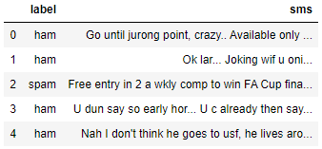
Loading the sms data into the project
Our data has two columns.
sms – containing the combination of words.
Label – Target variable.
We are going to use Natural Language Processing to understand to certain extent like text mining.

Slide 4
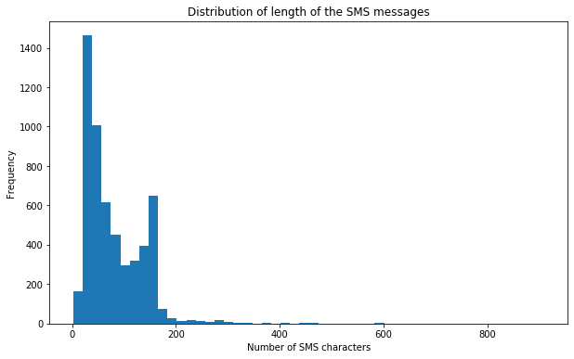
Visualizing the length of SMS messages
From the visualization, we can able to understand that most of the messages are of lesser length of 200 characters.
Distribution of the SMS length is right skewed.

Slide 5
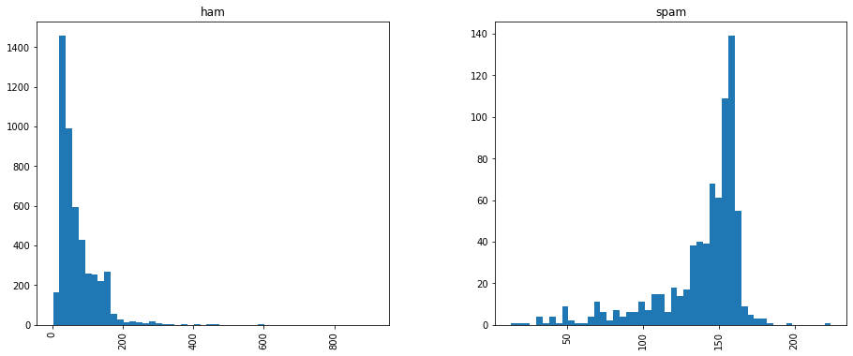
Visualizing length of ham & spam messages

Slide 6
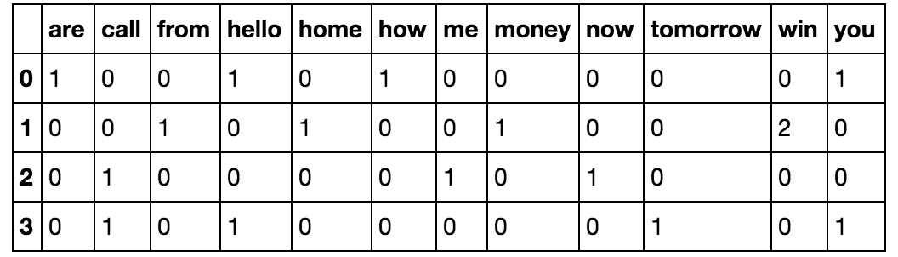
Bag of words approach
SMS Texts Messages
Hello, how are you!
2. Win money, win from home.
3. Call me now.
4. Hello, Call you tomorrow?

Slide 7
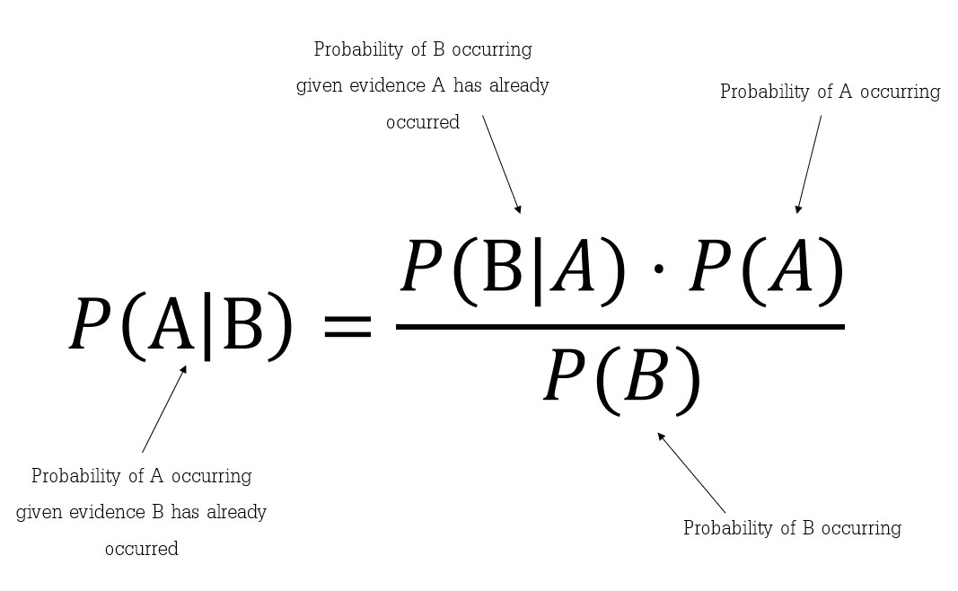
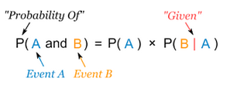
Model building - Naïve Bayes Classification
Why Naïve Bayes?
Best suited for discrete variables.
No interdependency of features.
What is Naïve Bayes?
Conditional Probability
Bayes Rule

Slide 8
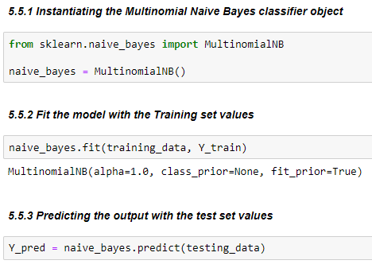
Implementing the Naive Bayes classification
We will be using the multinomial Naive Bayes implementation.
This particular classifier is chosen because, it is well suitable for classification with discrete features (such as in our case, word counts for text classification).

Slide 9

Model Building – Support vector classifier
Why SVM classifier?
Best suited for two class problems.
Outliers have less impact as line of separation depends on Support vectors.
What is SVM?
It is based on Marginal Hyperplane.
Kernel trick is used when classes are not linearly separable.

Slide 10
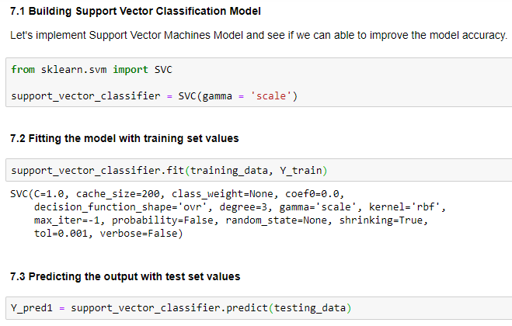
Building Support Vector Classification

Slide 11
Model evaluation
Naive Bayes model can predict the spam messages with 98.4% accuracy.
Support Vector Classification model can predict the spam messages with 99.01% accuracy.
Only 11 out of 1115 predictions are wrong from Support Vector Classification model
Naive Bayes model made 17 out of 1115 predictions wrongly.

Slide 12
conclusion
Based on our models built and evaluation criteria's,
For our data, Support Vector Classification seems to be the better model for making the futuristic predictions.
Thus, Support Vector Classification is the best model that can predict the future incoming spam messages more accurately for our business problem.

